Slide 1
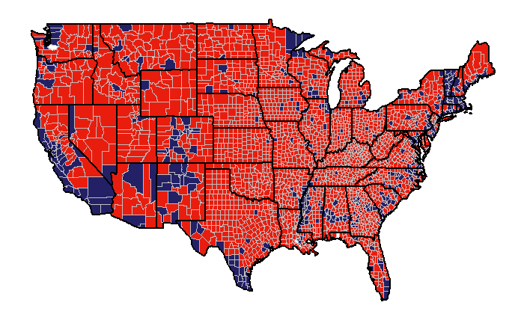
2016 US Election: County Analysis

Slide 2
Introduction
Purpose of Study
Determine the reason behind the switch from Democrats to Republicans in the 2016 US election
Why use counties?
Provides a segmentation of the United States
Demographic and voting results available
Cons of using county breakdown:
Voting habits and characteristic of individuals are masked
Provides a proxy for individual voting habits

Slide 3
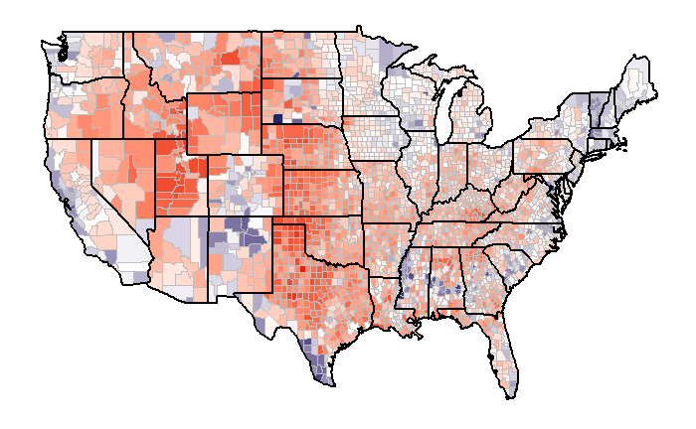
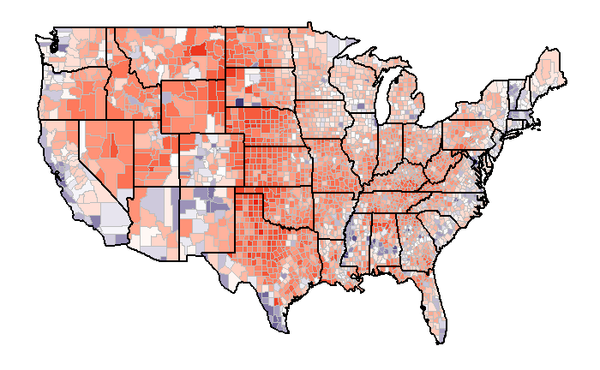

2012 and 2016 Election Summary: Outcome
2012 Election
2016 Election
Percent Differences
 | Counties Count | Percentage of Total
Republicans Majority | 2426 | 78%
Democrats Majority | 686 | 22%
 | Counties Count | Percentage of Total
Republicans Majority | 2624 | 84%
Democrats Majority | 488 | 16%

Slide 4

2012 and 2016 Election Summary: County Conversion
Of the 686 counties that voted Democrats in 2012:
218 voted for Republicans in 2016
468 voted for Democrats in 2016
Of the 2,426 counties that voted Republicans in 2012:
2,406 voted for Republicans in 2016
20 voted for Democrats in 2016
Percent Conversion
FROM / TO | Republican | Democrat
Republican | 99.2% | 0.8%
Democrat | 31.8% | 68.2%

Slide 5
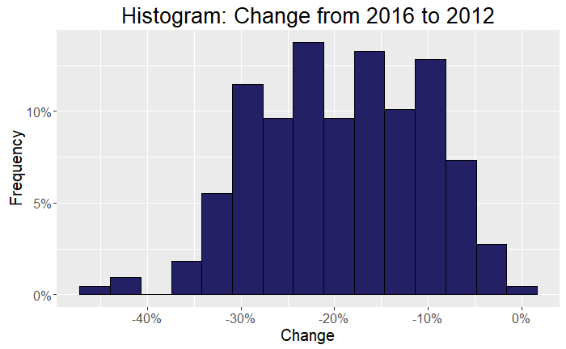
2012 and 2016 Election Summary: Why Democrats Loss
Key Reasons
Almost no conversion from Republican to Democrat
Gained no new base
Lots of Conversion from Democrat to Republican
Percent change from 2012 to 2016 were large
Potential concerns?
Do these groups share certain characteristics
Did the Democrats lost a core base?

Slide 6
Group Comparison: Definition
Why did some counties switch?
To investigate this:
Divided counties into two groups
Determine difference between two groups
1. Switched County
Democrat majority or balanced (>45%) in 2012
Democrat percent share decreased by 5% from 2012 to 2016
Republican majority in 2016
2. Remained County
Democrat majority or balanced (>45%) in 2012
Democrats percent share from 2012 to 2016 did not decrease by 5%
Democrats majority in 2016

Slide 7
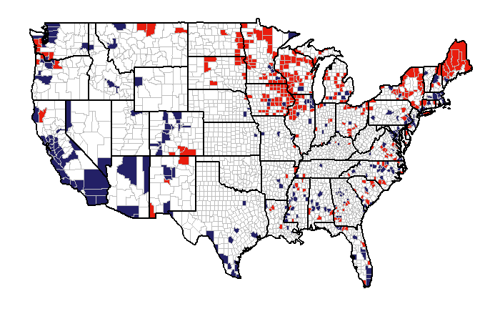
Group Comparison: Geographic Location
Switched Counties:
Geography concentrated in the Midwest and Northeast
323 counties in total
Remained Counties :
Geography concentrated to costal areas
284 counties in total

Slide 8
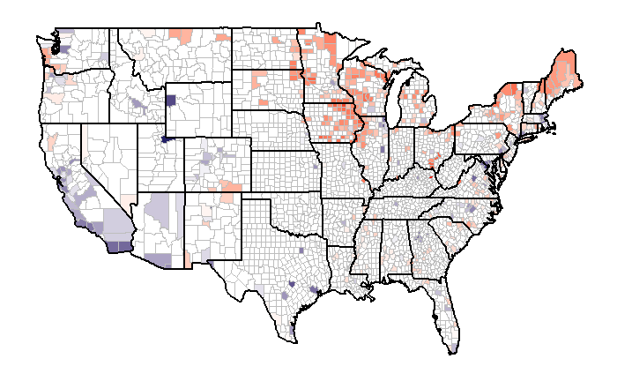

Group Comparison: Geographic Location
Switched Counties:
Two key regions with largest change

Slide 9
Group Comparison: Group Description and Comparison
Population Factors | Mean |  | Median
 | Switch | Remained | Switch | Remained
Population Size | 68,953 | 510,730 | 29,095 | 263,300
Population Density | 149 | 1714 | 44.7 | 519.6
Population Change (%) | -0.9% | 3.2% | -1.2% | 3.2%
Living in Place for +1 years | 87.5% | 83.1% | 88% | 83.7%
Multi-unit housing (%) | 13.4% | 27.6% | 12.2% | 26.5%
Switch counties tend to be:
Less densely populated
More rural
Have declining populations

Slide 10
Group Comparison: Group Description and Comparison
Age Factors | Mean |  | Median
 | Switch | Remained | Switch | Remained
Less than 18 | 21.7% | 22.3% | 21.6% | 22.5%
Between 18 and 65 | 54.4% | 57.7% | 54.3% | 56.7%
More than 65 | 18.4% | 13.8% | 18.1% | 13.5%
Switch counties tend to:
Have older populations
Education Factors | Mean |  | Median
 | Switch | Remained | Switch | Remained
High School | 86.5% | 86.1% | 88.1% | 87.9%
Bachelors | 18.7% | 32.2% | 17.5% | 32.3%
Switch counties tend to be:
More educated

Slide 11
Group Comparison: Group Description and Comparison
Housing Factors | Mean |  | Median
 | Switch | Remained | Switch | Remained
Home Ownership | 73.3% | 61.6% | 73.9% | 62.4%
Median House Value | 123,651 | 241,568 | 115,100 | 205,650
Household Size | 2.45 | 2.61 | 2.43 | 2.55
Switch counties tend to have:
Higher home ownership
Lower house values
Income Factors | Mean |  | Median
 | Switch | Remained | Switch | Remained
Income Per Capita | 23,565 | 28,731 | 23,557 | 27,580
Median Income Per Household | 45,661 | 54,804 | 45,667 | 52,363
Switch counties tended to have:
Higher Incomes

Slide 12
Group Comparison: Group Description and Comparison
Ethnic Factors | Mean |  | Median
 | Switch | Remained | Switch | Remained
White | 80.7% | 55.5% | 87.5% | 56.9%
Black or African American | 9.1% | 20.9% | 2.0% | 11.8%
Hispanic or Latino | 5.3% | 16.5% | 3.0% | 8.9%
Asian | 1.0% | 4.9% | 0.6% | 3.5%
Foreign Born | 3.0% | 12.2% | 2.2% | 9.3%
Speak second language | 6.3% | 19.9% | 4.6% | 13.1%
Switch counties tend to be:
More white
Have less foreigners

Slide 13
Group Comparison: Group Description and Comparison
Economic Factors | Mean |  | Median
 | Switch | Remained | Switch | Remained
Nonfarm Employment per Capita | 0.278 | 0.387 | 0.271 | 0.372
Firms per Capita | 0.081 | 0.093 | 0.079 | 0.084
Building Permits per Capita | 0.002 | 0.003 | 0.001 | 0.003
Retail Sales per Capita | 10.026 | 13.105 | 9.936 | 12.397
Wholesaler sales per Capita | 6.153 | 9.747 | 2.785 | 7.030
Acc. and food services sales per Capita | 1.16 | 2.456 | 0.965 | 1.838
Switch counties tend to be:
More farm employment focused
Less service economy focused

Slide 14
Predicting Conversion
Goal:
Determine what factors are the key predictors of whether a county switched
Tool:
logistic regression
Model accuracy of 96%
Key Factors:
1. Race:
Higher Probability of Switch
Higher Percentage of White
2. Education:
Higher Probability of Switch
Higher Percentage of Bachelors
3. Race:
Higher Probability of Switch
More rural
4. Race:
Higher Probability of Switch
Lower Percentage of woment

Slide 15
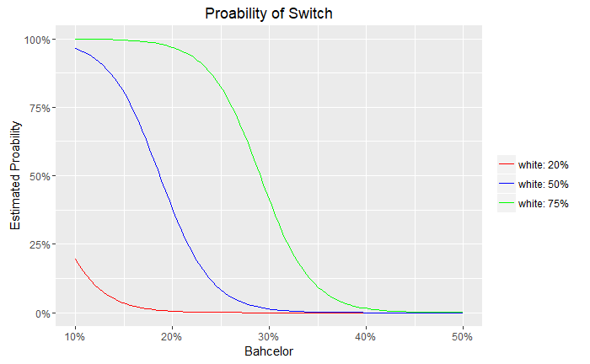
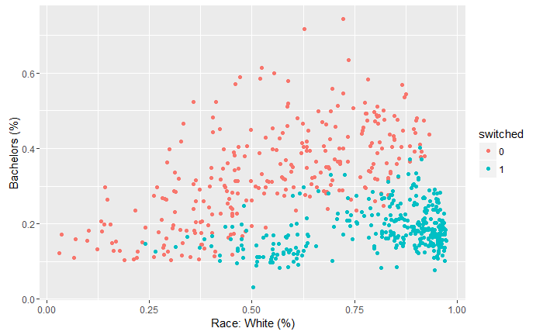
Relationship between Race and Education
Percentage of whites and Bachelor degrees is a strong predictor
White, educated counties overwhelmely voted Democrat
A model with only White and bachelor Percentage has accuracy of roughly 90%

Slide 16
Summary
From a county perspective, the driving force being the Democrat lost was due to a loosing a core group
This core group tend to be more:
More white
Less educated
More rural
Non service job oriented
Located in the Midwest and ___

Slide 17
Recommendations
Recommadions to Decmorates
The decomrates is out of touch with this group
This group will continue to have a dramatic impact in future elections
Unlikely that can win without them
What to do
Investigate these areas to determine why this base no longer supports them
Invest more resources into these regions
Ask them what they want, Not what you think they want
Different value systems

